Slide 1
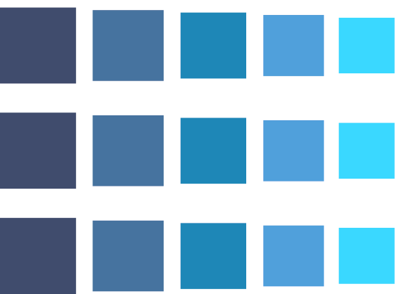



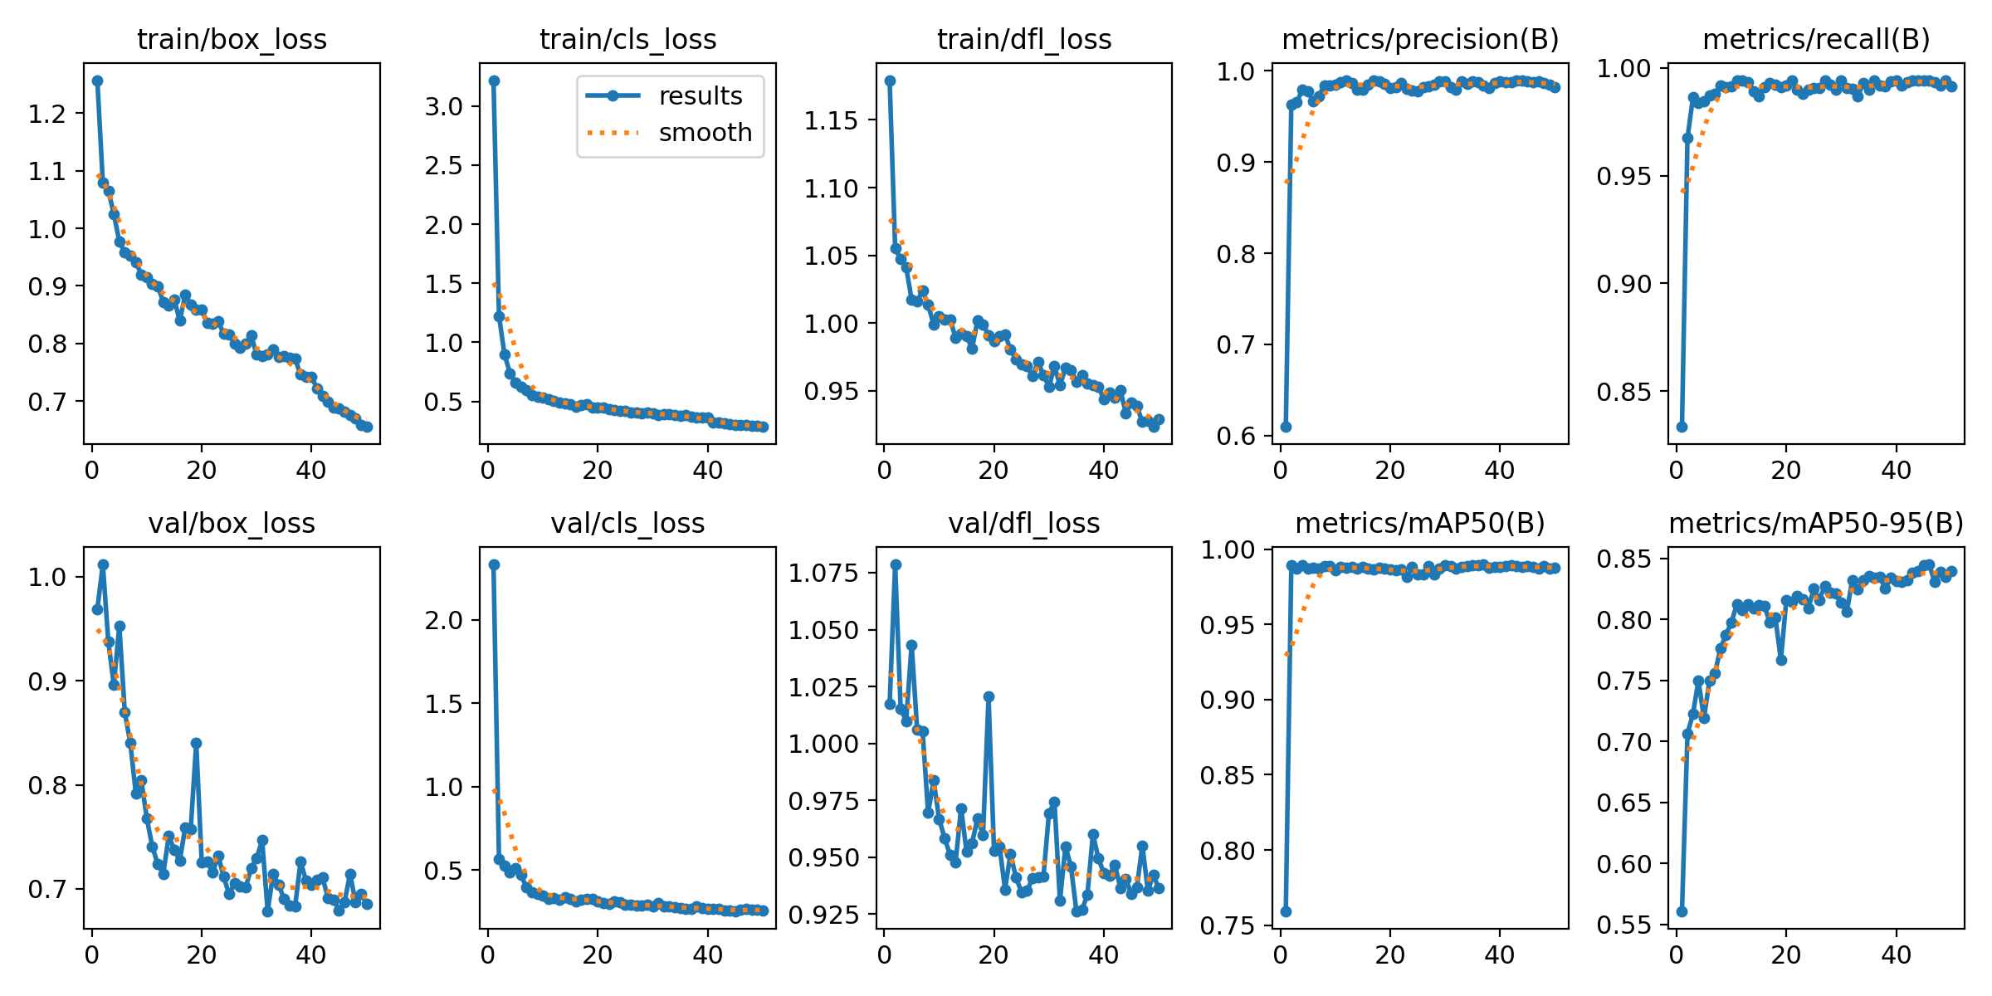
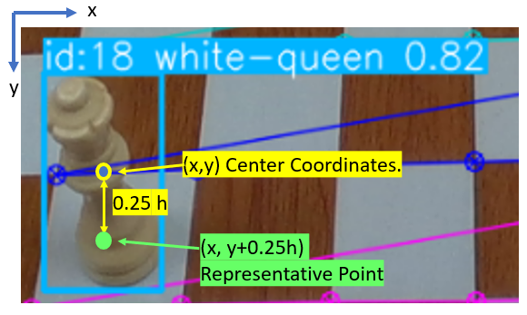
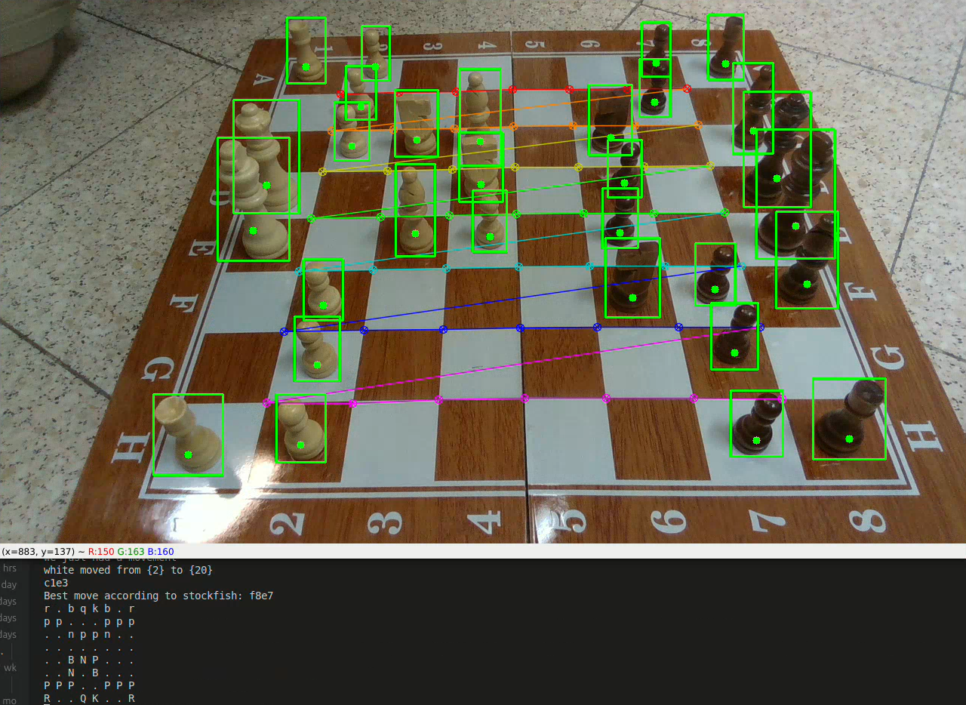
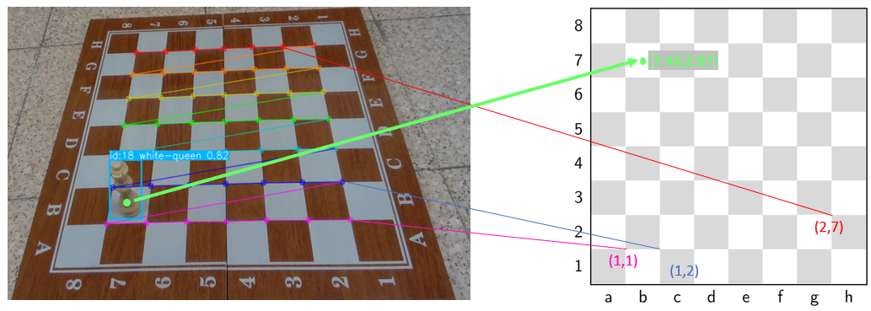
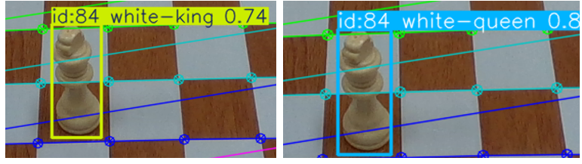
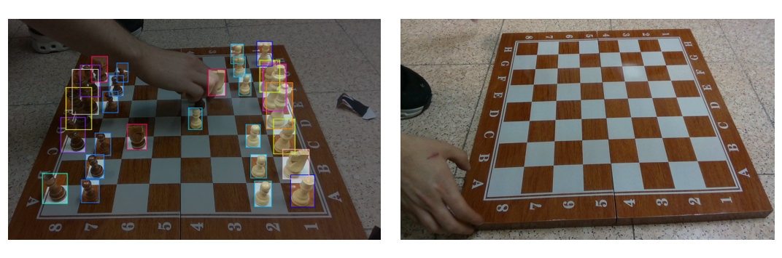
ChessCam: Live Chess Game Analysis
Aylon Feraru, Amit Butbul, supervised by Harel Yadid
The Problem
Piece Tracking
Results
Chess Players use Chess-Engines like Stockfish to analyze their games and offer counter moves.
Those Chess-Engines are inaccessible for games played on physical boards, unless the moves are painstakingly typed-in, or a specially designed but prohibitively expensive board is used.
Bridge the gap between physical games, and digital Chess-Engines.
Design a computer-vision based system, that receives as input a camera stream from an Intel-D435 camera, extracts the game state, and generates Chess-Engine recommendations based on the physical board footage.
A SORT algorithm is used, where every tracked piece has state:
Association between detections and tracked objects is based on the squared distance between the pieces and detection bounding box centers.
A point that represents the piece’s location on the board is extracted from its state.
Goal
YOLOv11 training graphs. Validation losses decrease smoothly.
Square detection and localization pipelines work consistently.
Lack of consistency in detection is compensated for well by square tracking.
Representative point computation diagram.
Piece Localization
Method
The board’s 49 corners are detected using cv2.findChessBoardCorners() and matched to a planar board.
The resulting Homography localizes the pieces.
extract the input RGB stream using pyrealsense.
Funnel the stream into YOLOv11s to identify the piece classes and bounding boxes.
Track the pieces using a modified SORT algorithm. Filter outliers.
Associate tracked pieces to chessboard squares using OpenCV functions.
Track piece identity with square occupancy differences.
extract recommendation from Stockfish with the pyChess python library.
Tracked game-state example and corresponding console output.
Detected corners are matched to planar ones. The transformed piece’s coordinates map it to a board square.
Conclusions
Square Tracking
We successfully built a system that bridges the gap between physical boards and Chess Engines.
The system works consistently within our constraints of legality and camera angle.
Logic for unique moves is required.
Dataset and Training
Square localization and Piece Tracking performed well under working assumptions.
Piece classification was unreliable. Most common errors encountered were flickering label issues, and misidentification.
We used a chess dataset that contained 292 images, supplemented by our own 50 images. 67 Images were used for validation.
We included images where the pieces are occluded, and images without pieces.
A test set wasn’t used since the system performance itself is our evaluation.
Mosaic, Flips, and brightness change augmentations were used.
Future Research
Flickering label error – label switches every few frames.
Enhanced detection by incorporating depth or using a multi-camera set-up.
Other approaches include increasing the training data, and using a chess set where the piece classes are more distinct.
Additional areas of improvement are the automatic detection that a move has been completed, and the incorporation of logic for special moves like castling, or en-passant.
Implementing Homography recalibration with SIFT and RANSAC.
To account for the classification errors, we assume the game configuration is the starting configuration.
The system holds two sets of occupied squares per color, and by comparing the current occupied squares to those in the previous move it infers the move made.
The moves are pushed to a pyChess Board object, and Stockfish is called to evaluate the new position.
Two images from our dataset, one containing occlusion (left) and a null image (right).
August 2025

